Slide 1



Nexora Bot
Structured. Unstructured. Web. One answer. Fetching answer wherever it is present.

Slide 2
Task list
User Authentication: To keep your data private and secure
User Sessions : To save uploaded documents, embeddings, chats.
Front End : Presentable front end using AI tools.
RAG on Variety of file formats : To get the answers from the variety of file formats.
Handling structured data: To handle structured data by executing SQL queries.
AI agent: Use of AI agents if required.

Slide 3
Task summary as per Nexora document.
Creating the frontend using AI platforms, integrating it with the backend, and ensuring successful deployment.

Slide 4







Technology Stack
Full-stack architecture powering intelligent document processing
Next.js
Clerk
Fast API
Poetry
Frontend
Authentication
Backend
Package Manager
Supabase
Tigris
boto3
Database
Simple Storage Service​
Presigned URL creation​
Redis
Celery
Docker
Message Broker
Tasks
Container
LangChain
Unstructured.io
OpenAI
ScrapingBee
Orchestration
File Processing
LLM, Embeddings
Web Scraping

Slide 5


Unstructured.io
Partition File
Chunk by title
partition_pdf(
strategy="hi_res",
infer_table_structure=True,
extract_image_block_types=["image"],
extract_image_block_to_payload=True)
Method:
unstructured.
chunking.
title.
chunk_by_title
Temp folder containing files

Slide 6
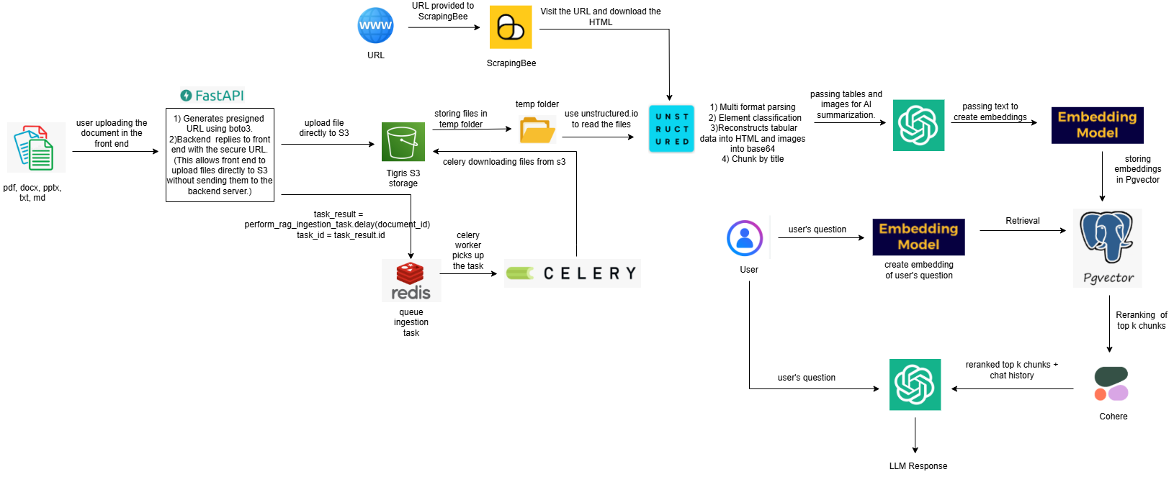
Architecture

Slide 7
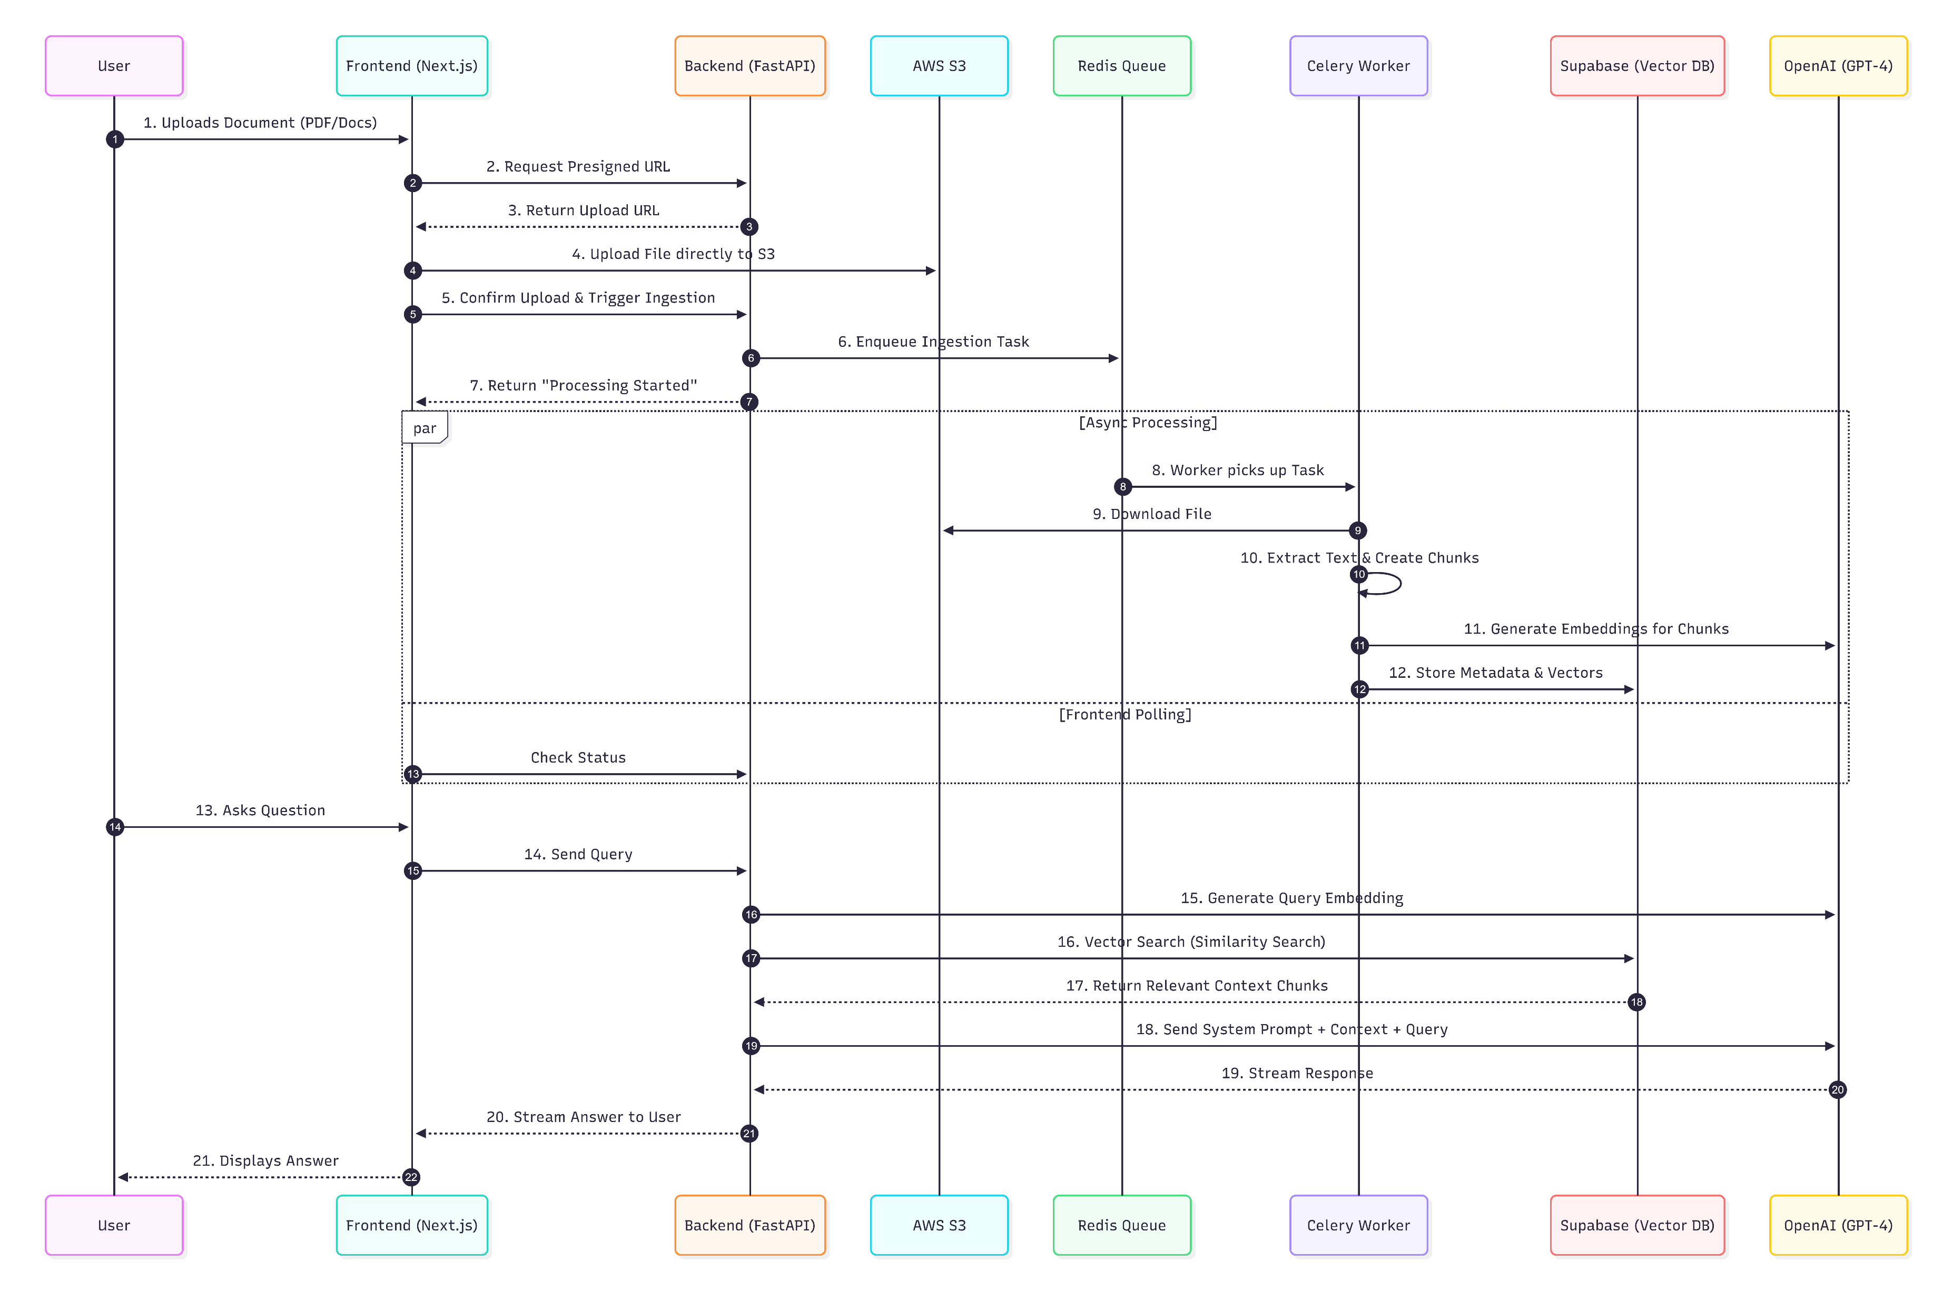

Slide 8
Thank you!

